Slide 1

Analysis for Annual Report on company’s Activities and Principal Findings
…a database solution for company’s products.

Slide 2
CONTENTS
Introduction 3
Database 4
Entity-Relationships 5
Analysis and Evaluation 6 - 8
Conclusion 9

Slide 3
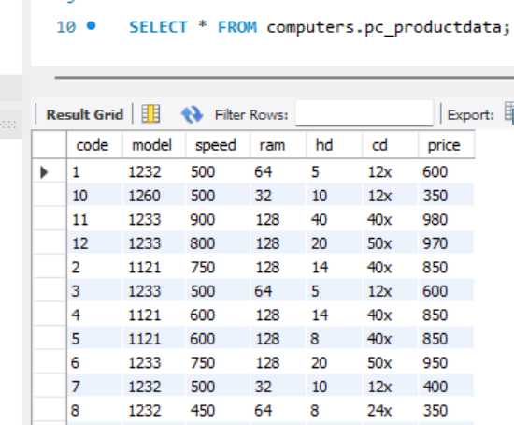
Introduction
It's becoming more difficult to control various data sources as data grows and multiplies. Due to this, businesses have to rely on databases to store and organize information in order to effectively manage and utilize data and manage product information.
In this context, this analysis was requested from the internal auditor at my company. It is a necessary requirement focused on product’s data collection and preparation for sales of computers, printers, and other hardware. Here, I will analyse the company’s PCs and their specifications.

Slide 4
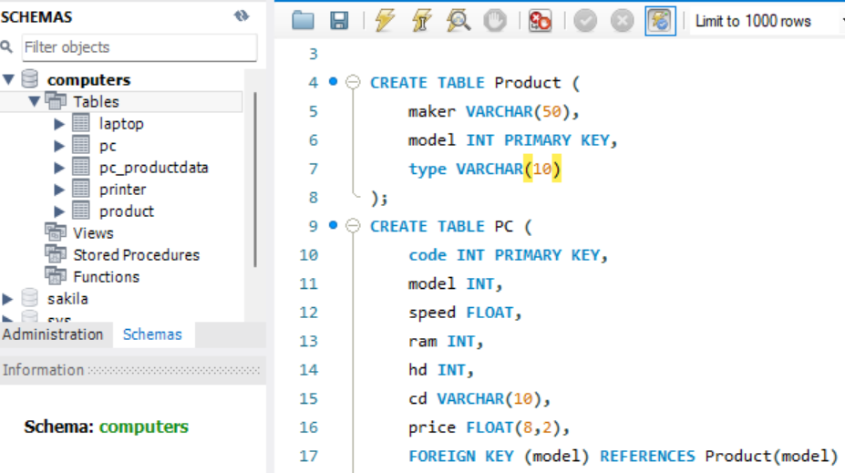
Database
A relational database management system
Data: “pc_productdata” containing 12 entries of PCs with specifications such as code, model, speed, RAM, hd, cd and price.
Schemas: A database (computers) consisting of products, laptop, PC, and printer tables.
Datatypes:
VARCHAR: characters
INT: integers
PRIMARY KEY: model, code
FLOAT: decimal
FOREIGN KEY: model
1
50 characters
10 characters
2
3

Slide 5
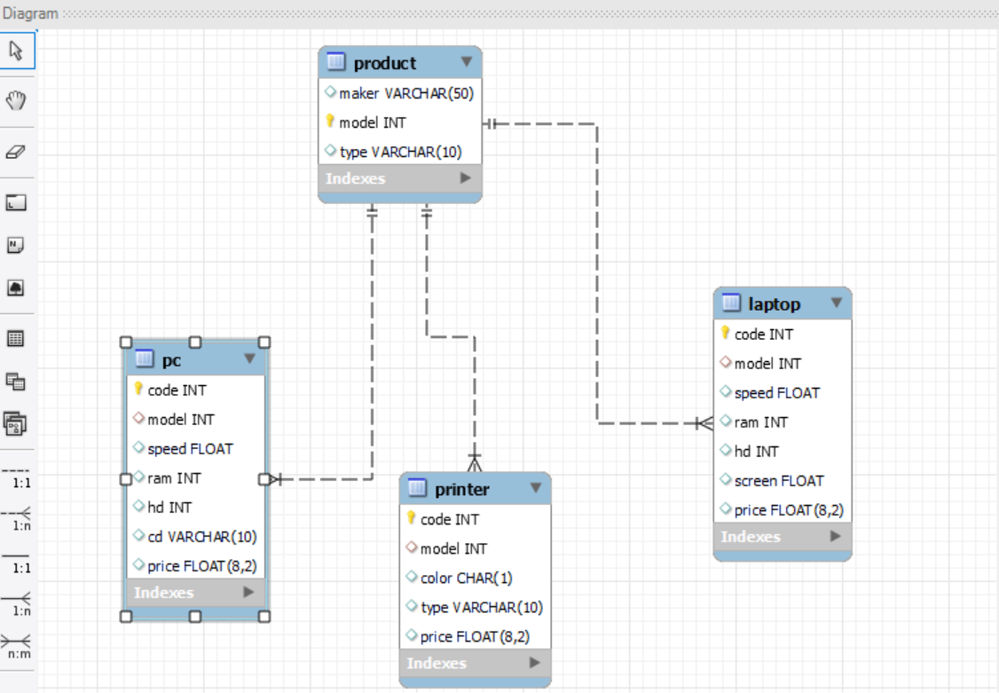
Entity-Relationships (ER)
To show the relationships between the entities (tables) with their respective information (columns), an ER diagram was created using reverse engineering on the SQL workbench.
Entities: The company’s database contains information on their products, organized into tables: Product, PC, Laptop, and Printer.
Make: manufacturer of the hardware products.
Relationship between tables:
Product – one-to-many;
PC and Laptop – many-to-one;
Printer - many-to-one.

Slide 6
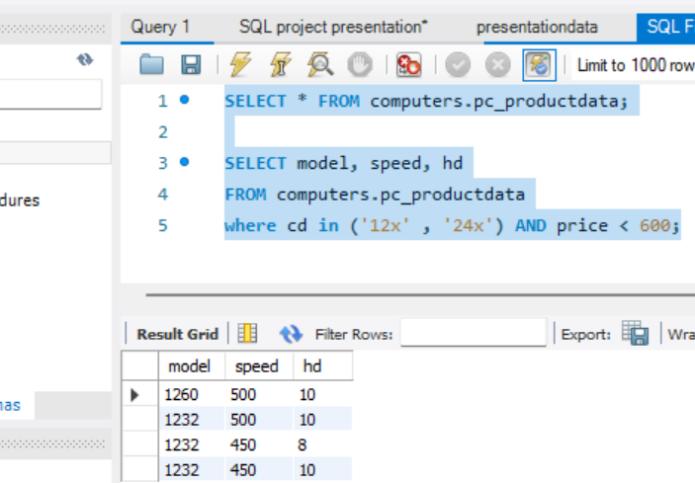
Analysis and Evaluation
Query 1
Task: Identify a specific set of personal computers that meet certain criteria based on their CD-ROM, speed and price
Personal computers with CD-ROM of "12x" or "24x“, and price less than £600.
Recommendations:
Market segmentation
Product bundling
increase sales and improve customer satisfaction

Slide 7
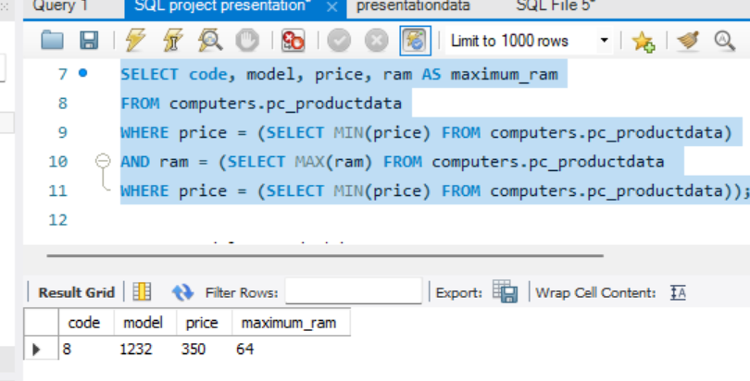
Query 2
Task: this query selects the conditions used to filter and select ONLY the
price of the PC with minimum price among all PCs in the table;
RAM of the PC with maximum RAM among all PCs in the table that have the minimum price.
Recommendations:
Monitor the price and RAM trends of PCs over time to identify market opportunities
Identify popular configurations
Targeted marketing and promotions: promote this product as a value-for-money option.

Slide 8
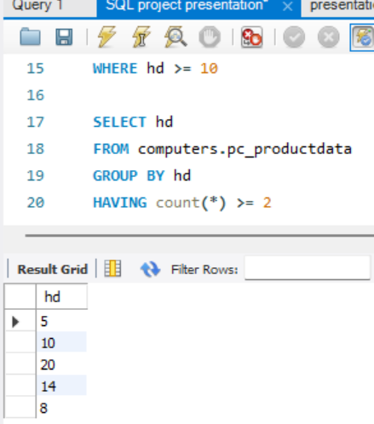
Query 3
Task: this query was used to select all hard drives (hd) values from the PC data table that appear in at least two (2) records.
Recommendations:
Identify common hard drive sizes across multiple PCs in the database,
Potential areas for optimization or standardization in hardware components
Streamlining production and procurement

Slide 9

Conclusion
Developing new products that align with customer preferences.
Improving existing products based on customer feedback
Adjusting pricing strategies to improve sales and revenue
making data-driven decisions to optimize production, marketing, and inventory management.

